Slide 1

Team Details
Team name : Era
Team Leader name :SujayKumar Reddy M
Idea : Developer Documentation LLMs (RAG based)

Slide 2
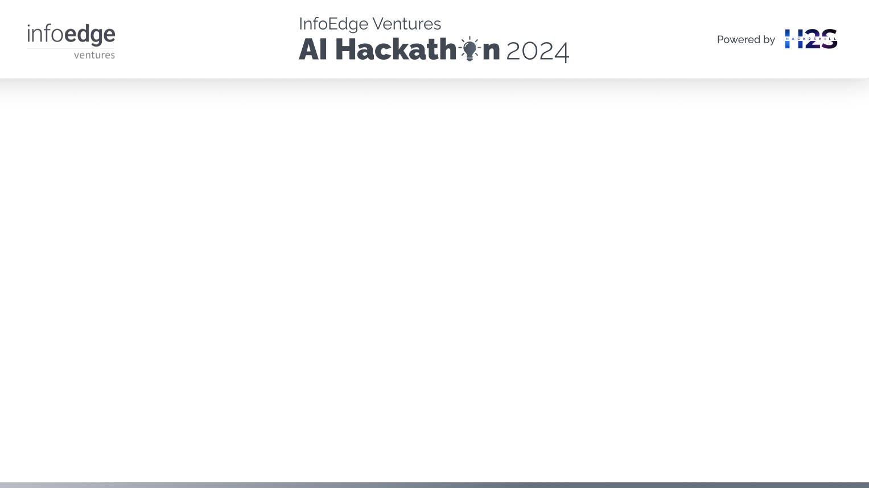
Brief about the idea
In recent years, there has been a notable surge in open-source projects since 2022.
Alongside this growth, contributions to these projects have increased significantly, leading to a corresponding rise in the number of reported issues.
The cost of building and maintaining an in-house documentation system is over $10,000. [archbee (2022)]
With the AI tools today, Code Documentation is possible and can be taken to the next level, Preferably by using LLMs.

Slide 3
Mintlify Doc Writer
This is one the recent products from Microsoft Store (Mintlify Doc writer) and even Microsofts Github Copilot can provide this. We will see more on how these Products can help us in acheiving more accuracy.

Slide 4
Opportunities
Say we want to learn an ML framework (sklearn) we don’t have to go through the website documentation.
Instead, we use a chatbot which knows everything giving out good examples also with less hallucinations. Considering “developer” as a stakeholder, there might be some more use cases.
Considering the project hierarchy and segmented data with the multi-programming Language Model (LLM) capability, our LLM is adept at understanding user queries related to specific programming languages related to the user context.
This approach ensures adaptability and efficiency, particularly in collaborative development environments with multiple users.

Slide 5
List of features offered by the solution
Version Control :
Re-computing the model centroids and frequently updating the vector DB for each commit and maintaining version control (excluding the need for the previous model).
Finetuning for each project/codebase :
Pipeline remains the same but the new vector database needs to be created for a particular repo name

Slide 6
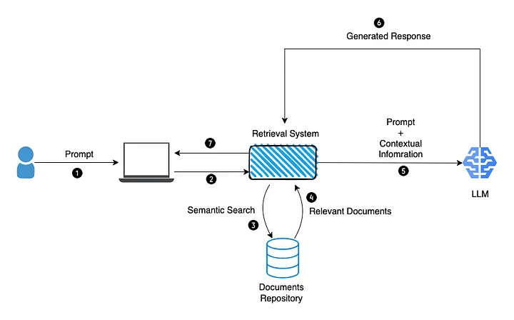
Process flow diagram

Slide 7
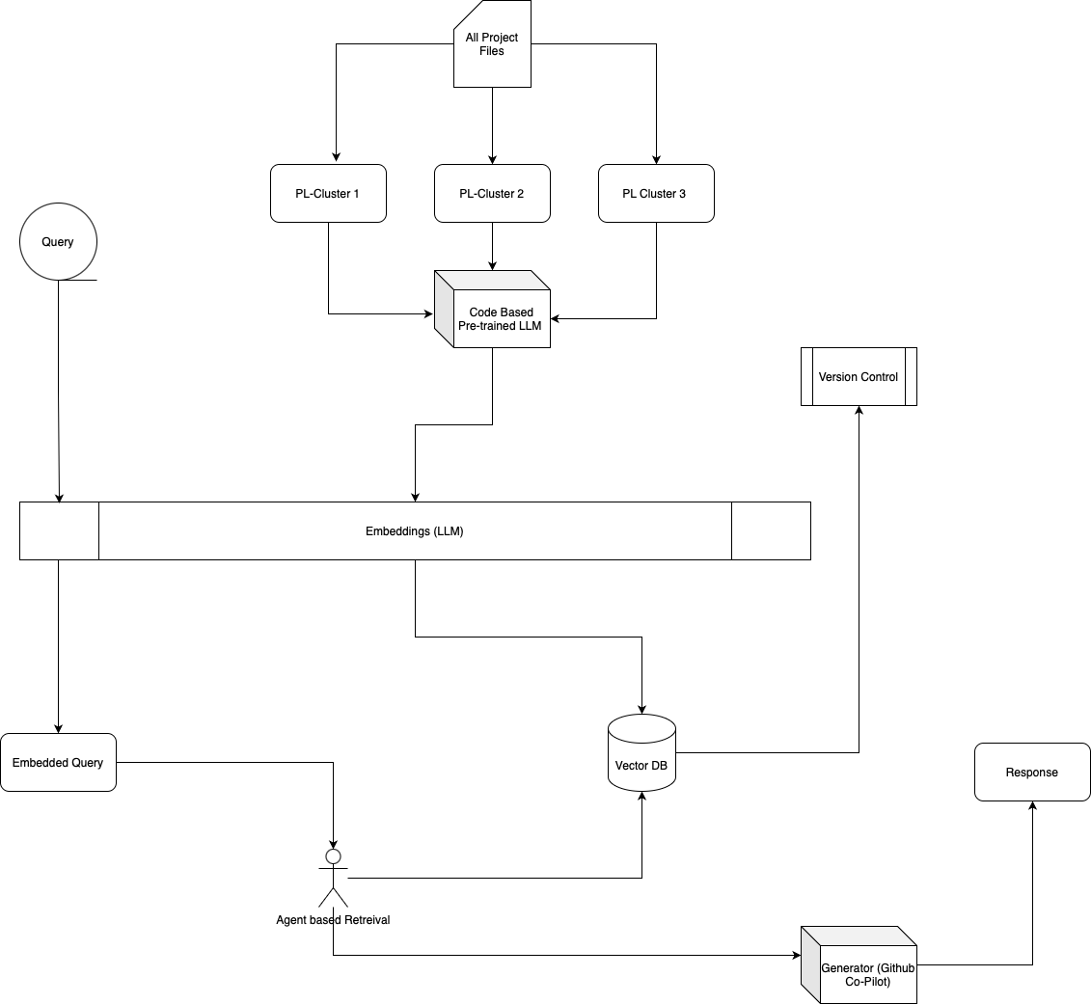
Architecture diagram of the proposed
solution

Slide 8
Technologies to be used in the solution
chroma-db (Vector-Database)
Llamaindex
Embedding model – llama2 (as of now)
Generation model – llama2 (as of now)

Slide 9
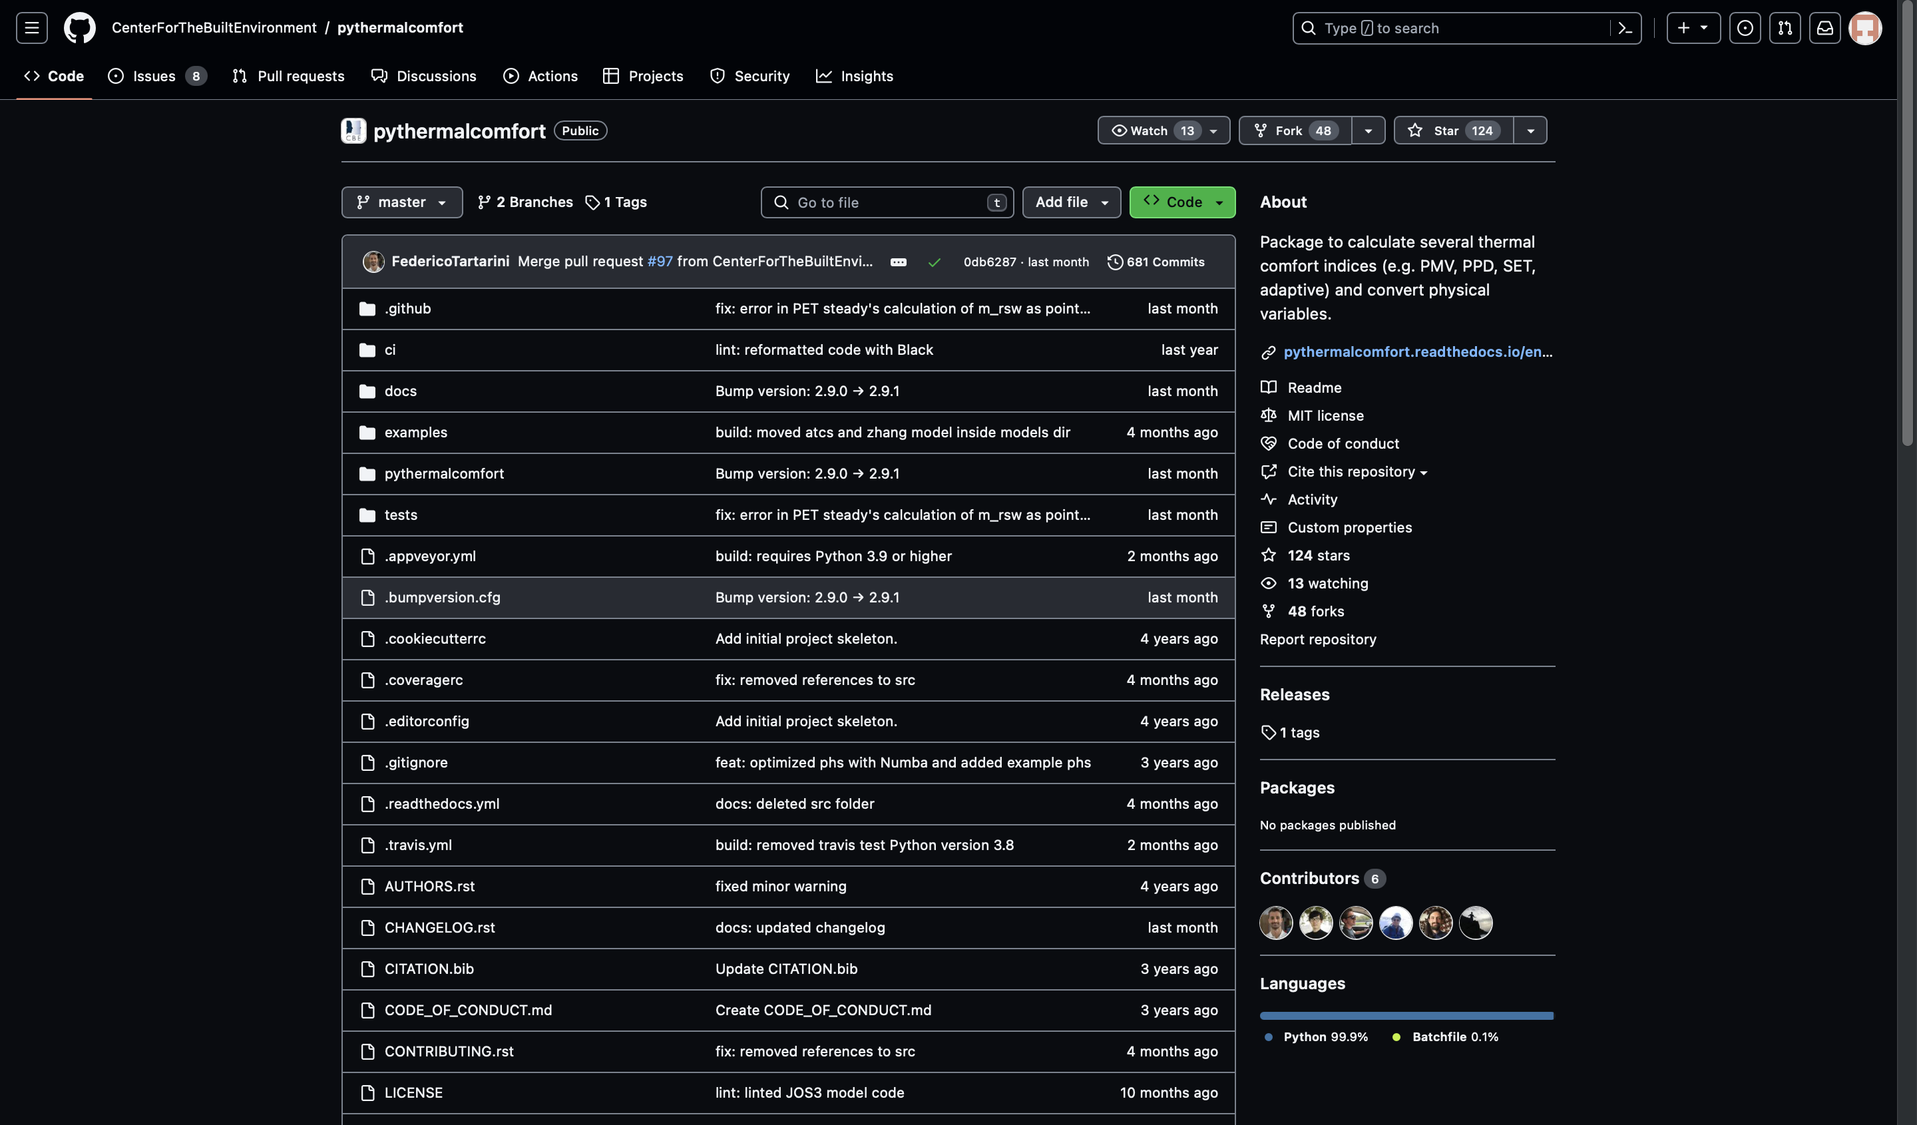
Prototype Performance report/Benchmarking
For Benchmarking we use pythermal comfort (a github package) to calculate several thermal comfort indices (e.g. PMV, PPD, SET, adaptive) and convert physical variables.
Predicting the thermal comfort indices for a particular person inside the room
https://github.com/CenterForTheBuiltEnvironment/pythermalcomfort

Slide 10
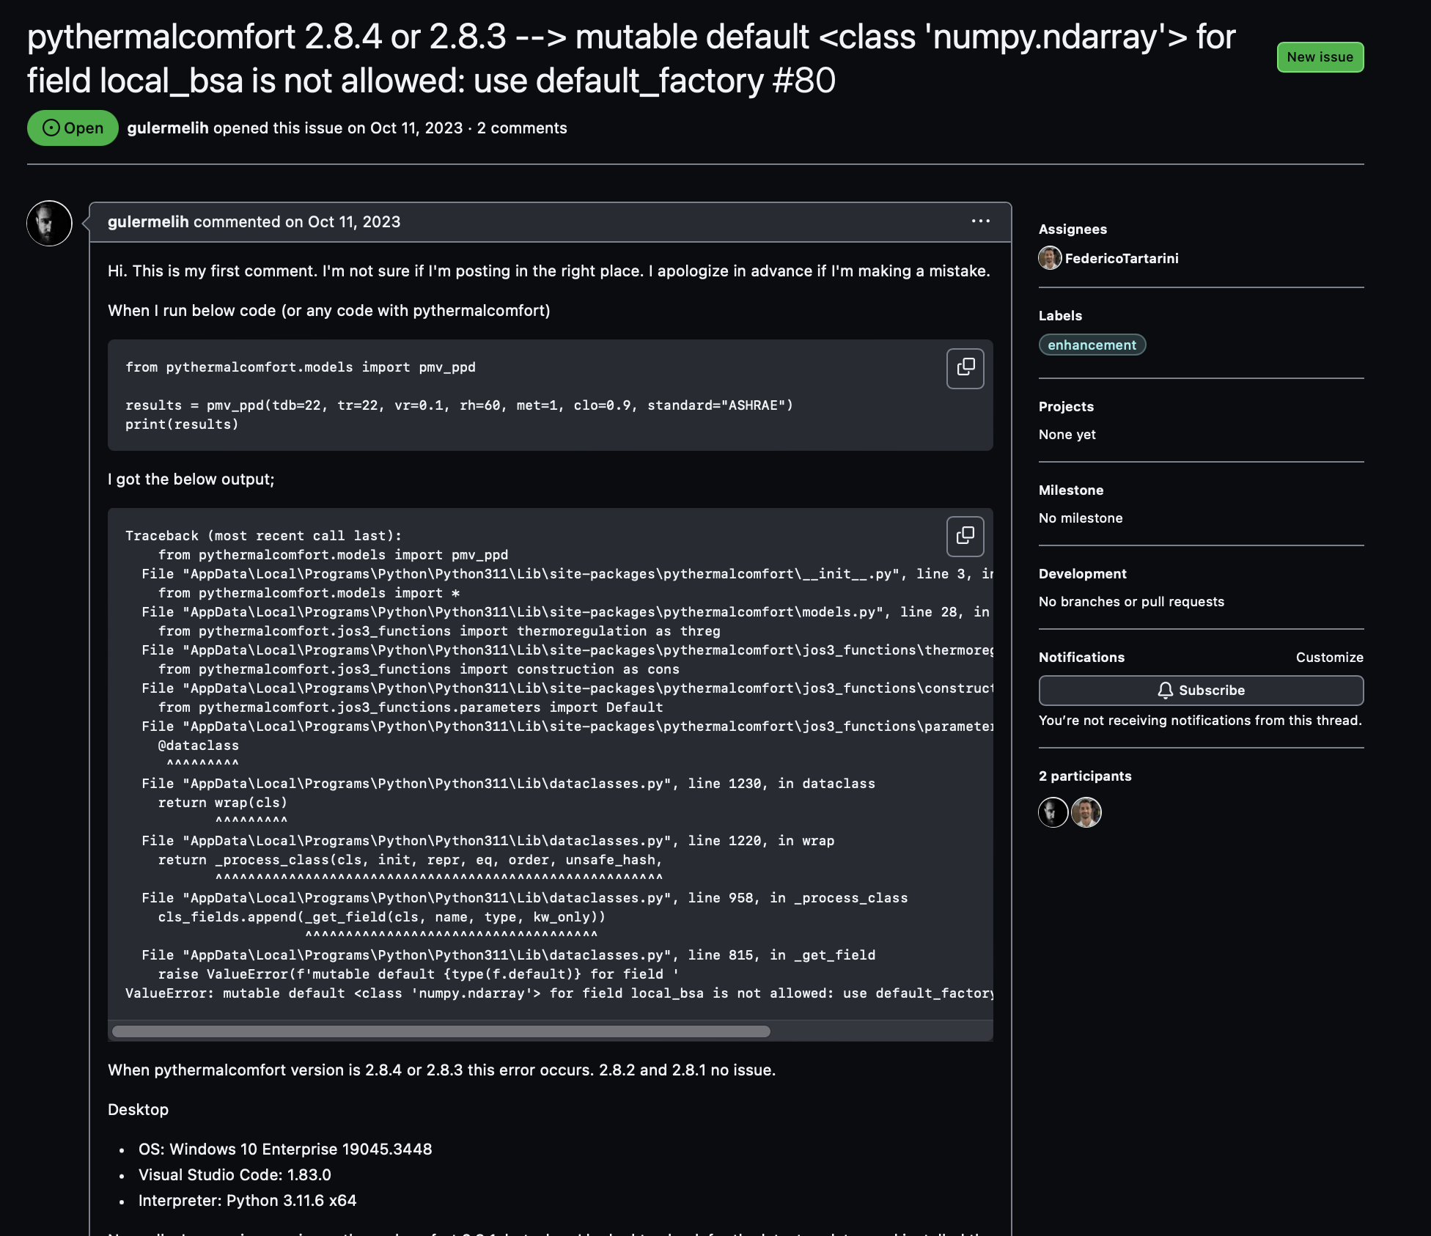
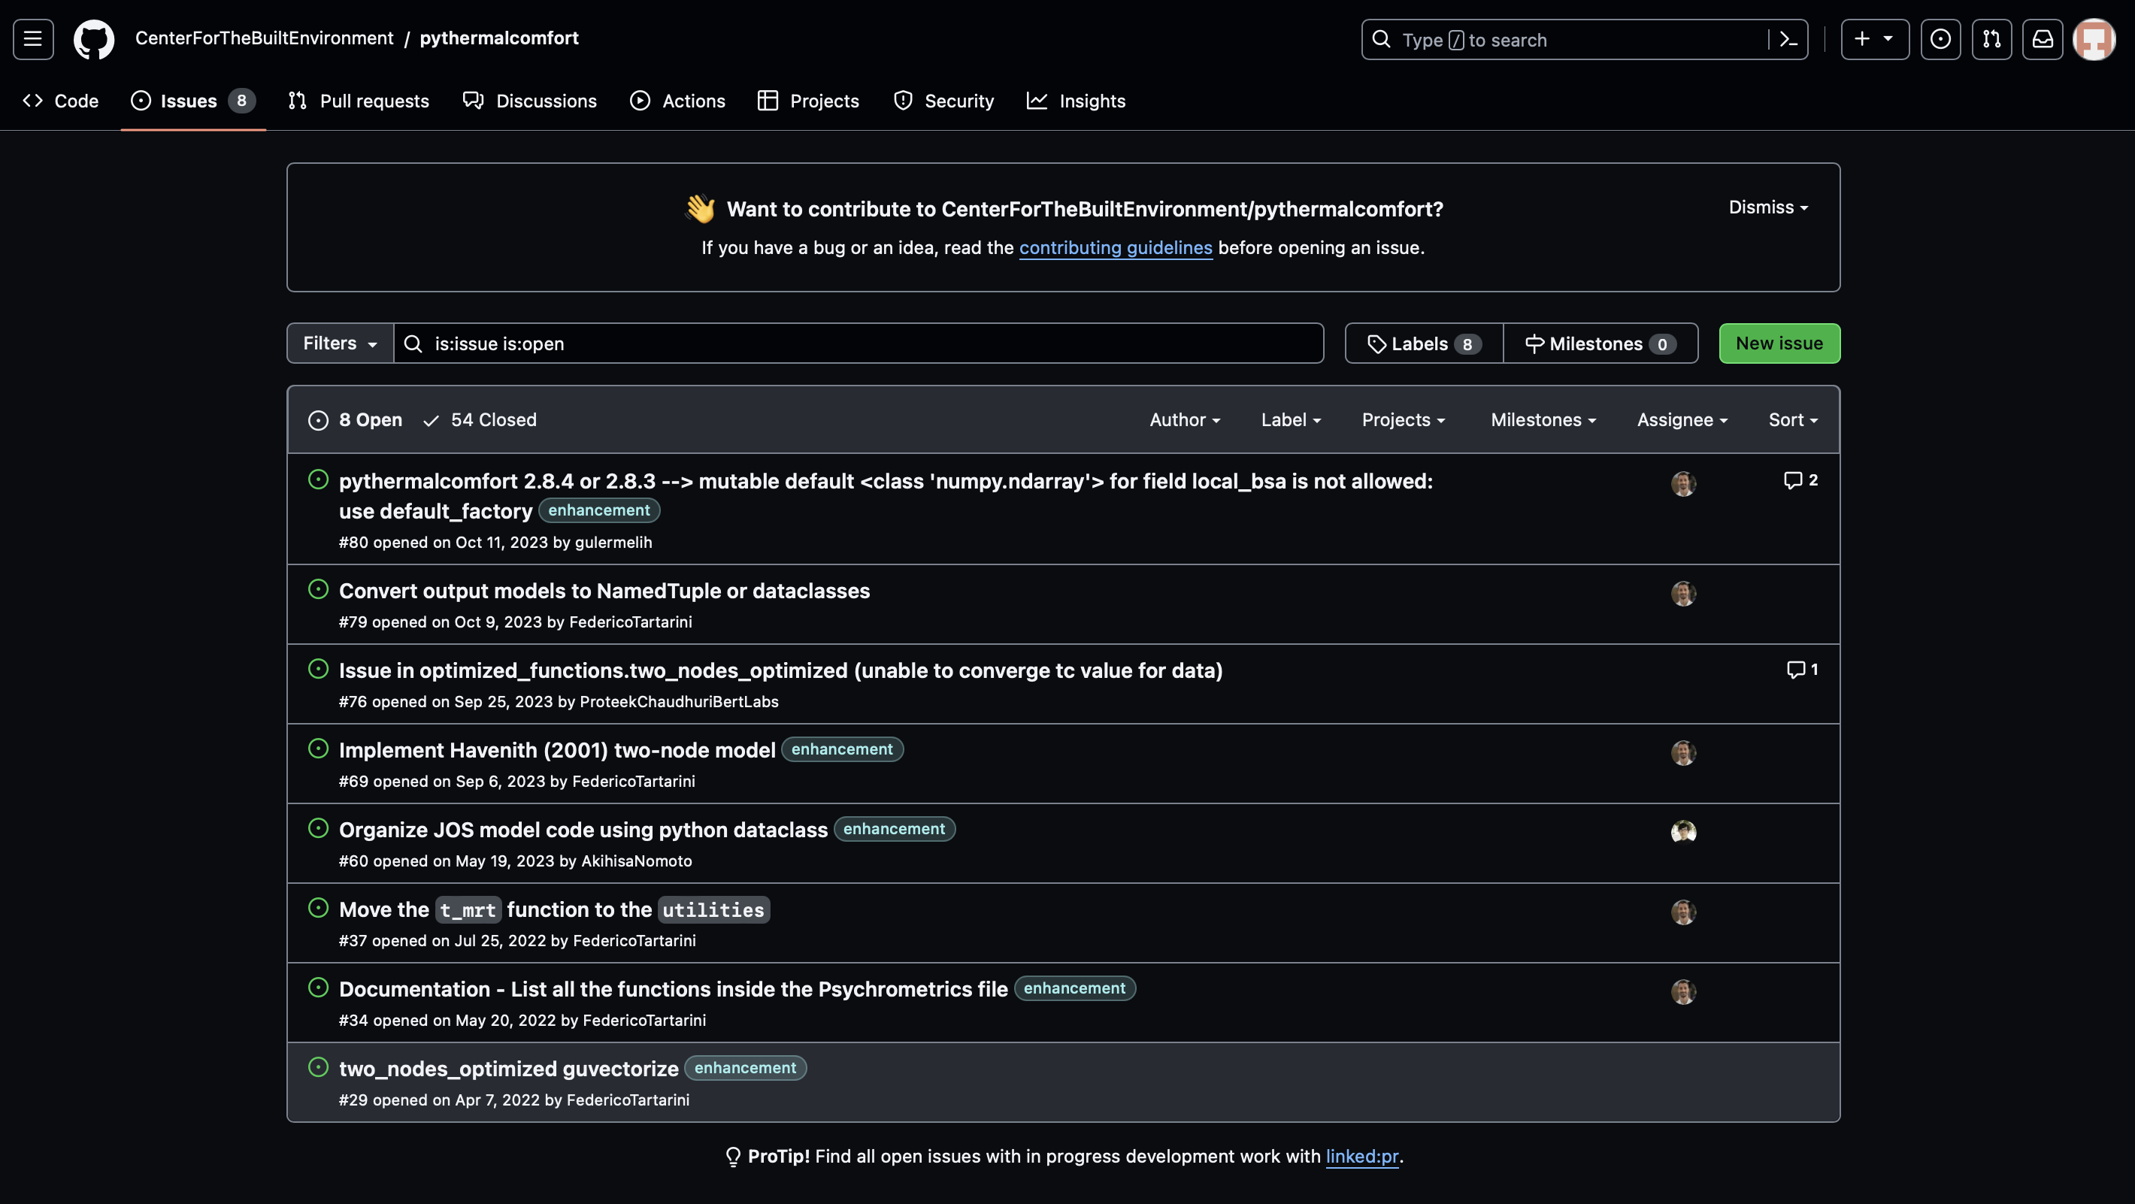
Prototype Performance report/Benchmarking
We tested the queries and prompt using the Github Issues Tab. The question will be the prompt and the answer is the top answers in the Github Issues.

Slide 11
Snapshots of the prototype
This is one of the result from the Retreival process and top centroid which shows higher correlation of context by extracting the code from the examples folder of the project and augmenting it to the LLMs. We used the MiniLM Embedding model in-order to store the LLMs and chromadb is used for the vector DB.
from pprint import pprint
from pythermalcomfort.models import adaptive_en,pmv_ppd
from pythermalcomfort.utilities import running_mean_outdoor_temperature
result = adaptive_en(tdb=25, tr=25, t_running_mean=24, v=0.1)
pprint(result)
result = adaptive_en(tdb=22.5, tr=22.5, t_running_mean=24, v=0.1)
pprint(result)
comf_tmp = result["tmp_cmf"]
result = adaptive_en(tdb=72.5, tr=72.5, t_running_mean=75, v=0.1, units="IP")
pprint(result)
rmt_value = running_mean_outdoor_temperature([29, 28, 30, 29, 28, 30, 27], alpha=0.9)
result = adaptive_en(tdb=25, tr=25, t_running_mean=rmt_value, v=0.3)
pprint(result)
result = pmv_ppd(tdb=22, tr=22, vr=0.1, rh=60, met=1, clo=0.9, standard=“ASHRAE")
pprint(result)

Slide 12
GitHub & Demo video URL
Github Link : https://github.com/sujaykumarmag/RAG_LLM

Slide 13
Additional Details/Future Development
Github based Add on Software Product
Federated LLMs for each user/branch for a Repo
Replacement of Chatbots instead of webpages.
Less webpages less server storage, while the computation grows.

Slide 14


